Slide 1
Deep Learning
Convoluted Neural Networks Session 5
( Disclaimer: Content has been taken from various authors and websites)
Notes:
7/22/18
1

Slide 2
Today’s Agenda
Recap of Last Presentation.
Generative Adversarial Networks
Questions.

Slide 3
GlobalAveragePooling
It’s a pooling scheme, that averages out all the features within a feature map
If we had a feature map
height x width x depth
Global Average Pooling would reduce it to
1 x 1 x depth
Jupyter Notebook
clothesClassifier – Deep CNN-Global Average Pooling
clothesPredictor – Deep CNN-Global Average Pooling

Slide 4
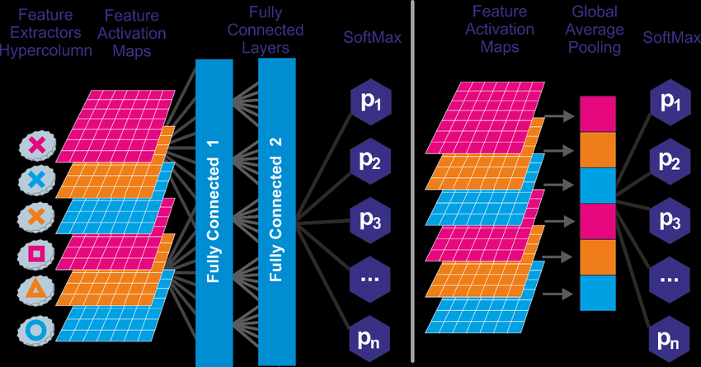
GlobalAveragePooling

Slide 5
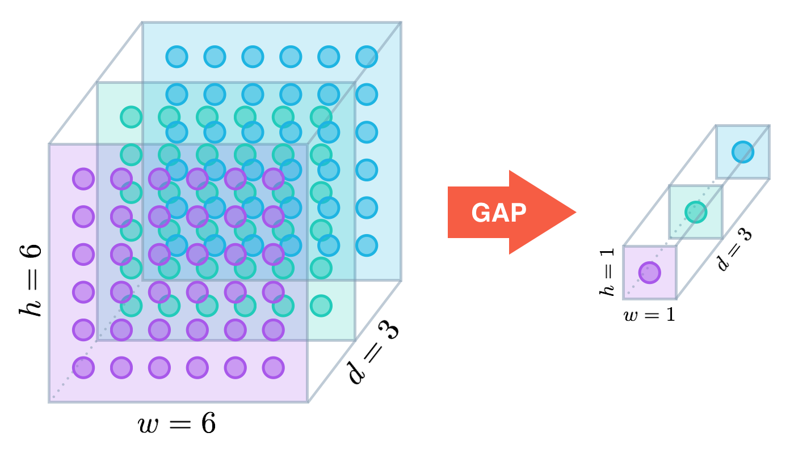
GlobalAveragePooling

Slide 6
ClothesClassifier Demo
Jupyter Notebooks
clothesClassifier – Deep CNN.ipynb
Clothes Image Predictor.ipynb
Clothes Adversarial generator.ipynb

Slide 7
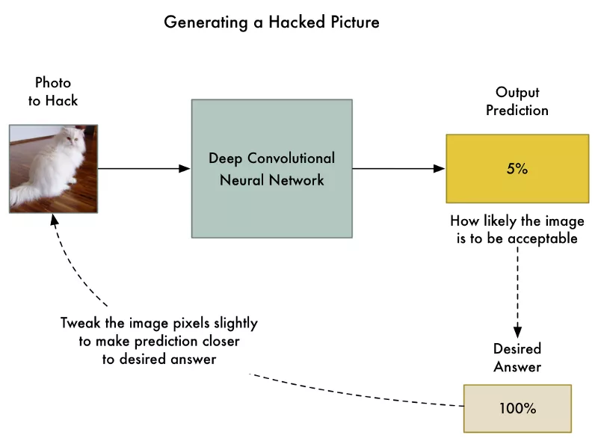
Adversarial Examples - Recap
Steps
Feed the photo to hack.
Check the neural network’s prediction and see how far off it is from the answer we want to get for this photo.
Tweak our photo using back-propagation to make the final prediction slightly closer to the answer we want to get.
Repeat steps 1–3 a few thousand times with the same photo until the network gives us the answer we want.

Slide 8
GANS
Generative Adversarial Networks
GANs were introduced by Ian Goodfellow in 2014
(https://arxiv.org/abs/1406.2661)
(http://slazebni.cs.illinois.edu/spring17/lec11_gan.pdf)
A form of Unsupervised learning.

Slide 9
Why Generative Adversarial Networks (GANS)
Use new Algorithmic approaches and powerful compute to avoid Data Problem
.

Slide 10
Thought Exercises
Line Drawings

Slide 11
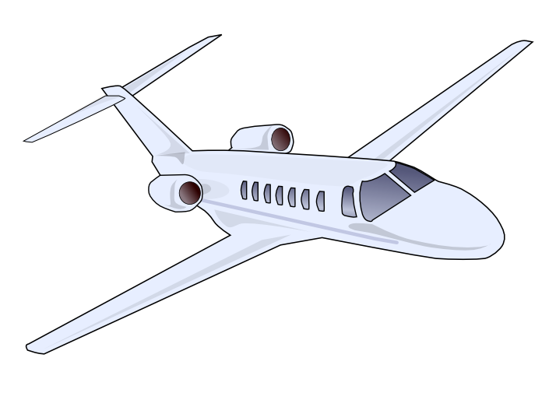
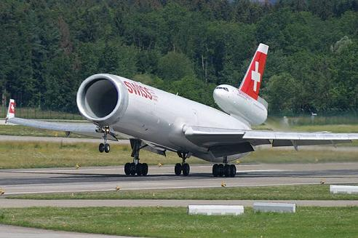
What Do you see Why do you call it a ………….. Attributes ????

Slide 12
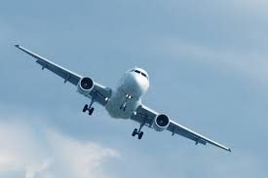
To Generate a picture of Something, you must have an understanding of it.
What is in the picture.
It has Wings, Engines, Cockpit, Wheels, Flaps, Body of a plane.
To the computer it is just a grid of numbers.
It has no understanding what the picture represents.
If we show thousands of pictures of planes to the NN, after seeing those pictures, the NN can generate a new picture of a plane, it would show that the NN knows what different parts go into a the making of the plane, even thought we have not told it.
This seems a way to train NN to understand concepts, without explicitly taught the meanings of those concepts.
GANS are uniquely able to learn from the data with no knowledge of its underlying distribution.
GANS came make sense of complex disparate data, and create compatible or matching examples.

Slide 13
Thought Exercises
Draw a Picture of an Apple.
Draw a picture of a Jackfruit

Slide 14
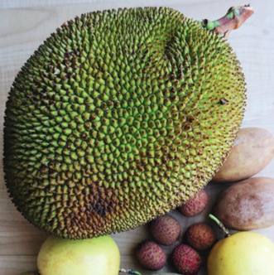
JACKFRUIT

Slide 15
Do note, that I have shown you 1 picture of a jackfruit, and you have been able to
Learn it, and have a basic understanding of it.
The Neural Net on the other hand, needs a large number of Jackfruit images to be able to classify or label an image as jackfruit.
MAIN TAKEAWAY: NN require lot of DATA.

Slide 16
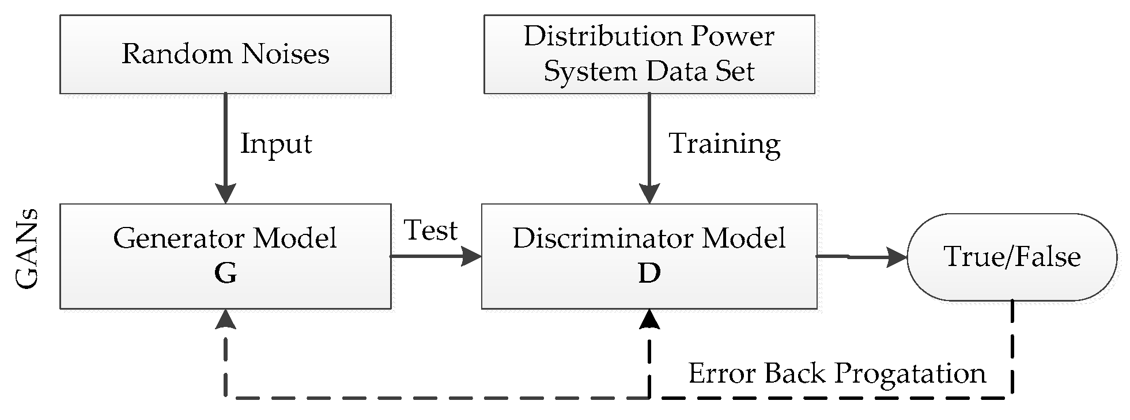
Generative Adversarial Networks
GANs are NN that learn to create synthetic data similar to some known input data.
They have two models.
Generator Model
Takes random input values and transforms them into images through a deconvolution NN
Discriminator Model
A CNN Binary classifier that determines whether a given image looks like a real image from the dataset or its different.
What Happens:
Over the course of many training iterations, the weights and biases in the discriminator and the generator are trained through backpropagation.
The discriminator learns to tell "real" images from "fake" images created by the generator.
At the same time, the generator uses feedback from the discriminator to learn how to produce convincing images that the discriminator can't distinguish from real images.

Slide 17
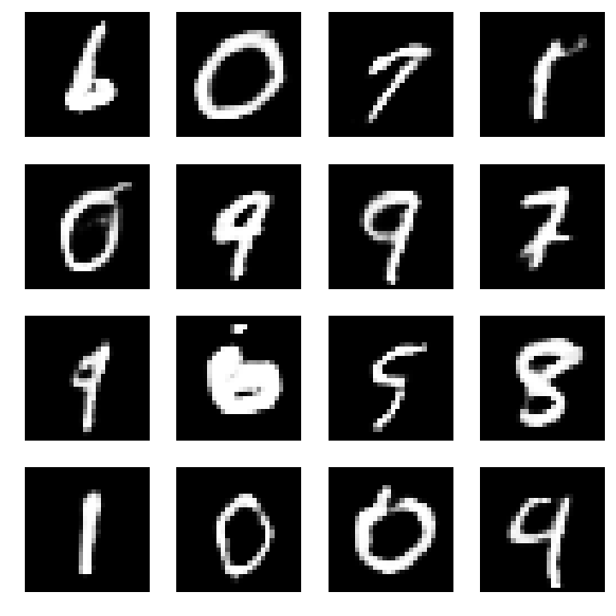
Which age group wrote this……
Age 3-5
Age 6-10
Age 11-20
Age 80-90

Slide 18
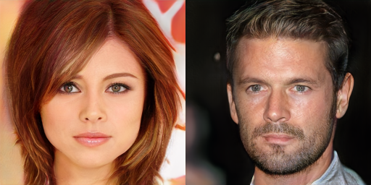
Identify them ???

Slide 19
Identify them ???
Two imaginary celebrities that were dreamed up by a random number generator (GAN).
http://research.nvidia.com/publication/2017-10_Progressive-Growing-of

Slide 20
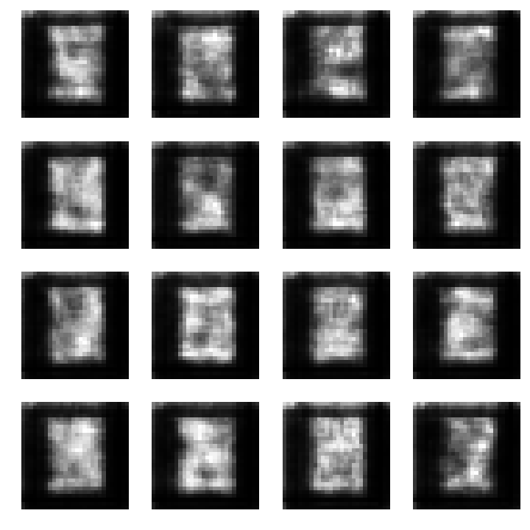
Those numbers were made by a GAN,
Random Noise
After 50 Iterations

Slide 21
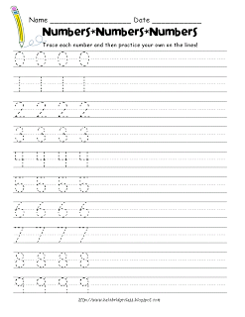
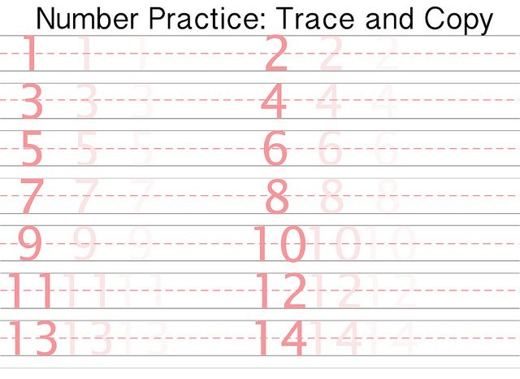
How does a human learn numbers

Slide 22
Thought Exercise
Discriminator trained in Mandarin language (Chinese)
Generator has no knowledge of Mandarin language

Slide 23

Sun

Slide 24
MNIST DEMO
MNIST Generator
c:\\users\ali\trainging projects\\mnist-gan.py

Slide 25
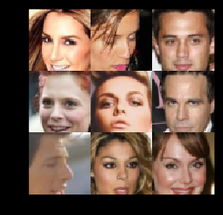
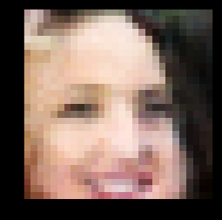
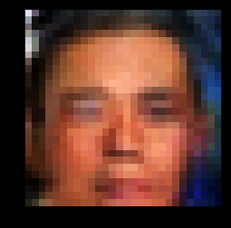
Celebrities Faces Demo
Images we learnt from
Images Generated by our GAN

Slide 26
GAN Applications
Font Generation (https://github.com/kaonashi-tyc/zi2zi)
Image Generation
Text 2 Image Generation(https://arxiv.org/abs/1605.05396)
Image Sharpening
Music Generation (https://arxiv.org/abs/1703.10847)
(https://salu133445.github.io/musegan/results)
Style Transfer (https://github.com/junyanz/CycleGAN)
Adversarial Attacks
Synthetic Data Generation
Face Aging (https://arxiv.org/pdf/1702.01983.pdf)

Slide 27
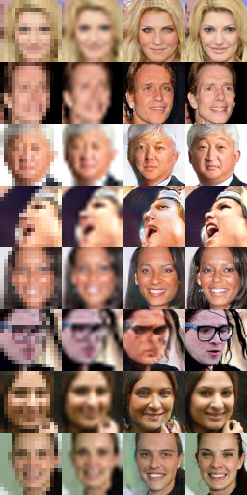
Image Sharpening

Slide 28
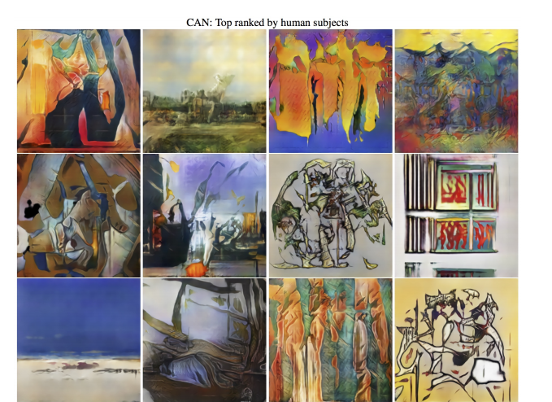
https://arxiv.org/pdf/1706.07068.pdf

Slide 29
Types of GANS
Deep Convolutional GANs (DCGANs)
First major improvement on the GAN architecture.
More stable in terms of training and generate higher quality samples.
Batch normalization is a must in both networks.
Fully hidden connected layers are not a good idea.
Avoid pooling, use convolutions!
ReLU activations
Conditional GANs (cGANs)
Use extra label information. This results in better quality images and being able to control – to an extent – how generated images will look.
Wasserstein GANs
Change the loss function to include the Wasserstein distance. As a result, WassGANs have loss functions that correlate with image quality. Also, training stability improves and is not as dependent on the architecture.

Slide 30
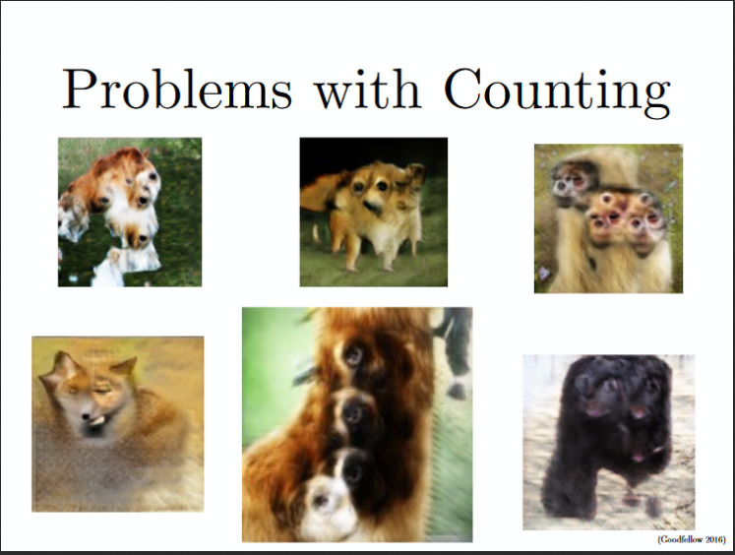
ISSUES with GANS
Problem with Counting: GANs fail to differentiate how many of a particular object should occur at a location.

Slide 31
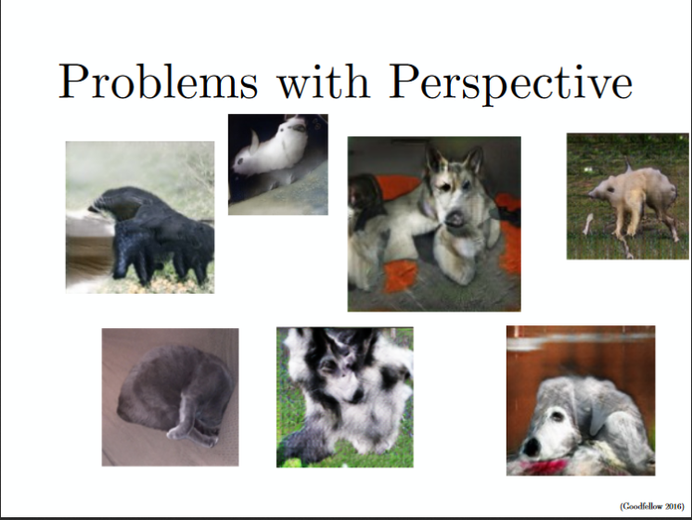
Problems with Perspective: GANs fail to adapt to 3D objects. It doesn’t understand perspective, i.e.difference between frontview and backview. As we can see below, it gives flat (2D) representation of 3D objects

Slide 32
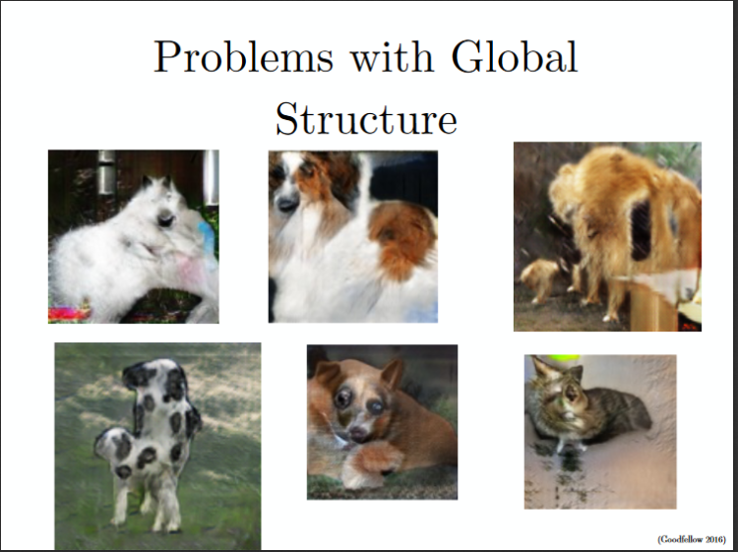
Problems with Global Structures: Same as the problem with perspective, GANs do not understand a holistic structure. For example, in the bottom left image, it gives a generated image of a quadruple cow, i.e. a cow standing on its hind legs and simultaneously on all four legs. That is definitely not possible in real life!

Slide 33
Training GANS
Successful Training is a matter of experience- balance learning rate,
how often the generator Is updated vs the Discriminator ….
MODE Collapse
Generator keeps generating very similar images
Difficulty in reaching convergence
Generator and Discriminator losses keep oscillating
Network does not converge to an optimal solution.
Relative Strengths of the two Networks
Either of the 2 network becomes very strong, neither learns
from this point onwards.

Slide 34
Tricks to Train GANS
Normalize images: Images are normalized between 1 and -1
Inverting Labels: while training generator, flip labels sent to the Discriminator.
Schedule for training G and D: Train on a loss schedule.
Noisy D Input: Add noise to input of Discriminator.

Slide 35
Further Readings
Generative Adversarial Networks
https://github.com/zhangqianhui/AdversarialNetsPapers
https://github.com/nightrome/really-awesome-gan
https://carpedm20.github.io/faces
https://github.com/dmonn/dcgan-oreilly/blob/master/DCGANs%20with%20Tensorflow.ipynb
Adversarial Examples
https://aaai18adversarial.github.io/

Slide 36
Contact Details
Email: aliasgertalib@gmail.com
Linkedin: https://www.linkedin.com/in/aliasgertalib
GitHub
https://github.com/aliasgertalib-AI

